Slide 1



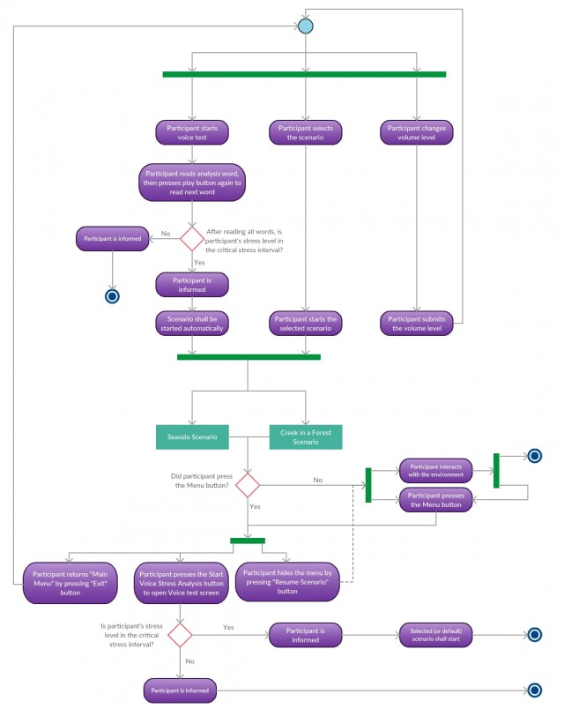
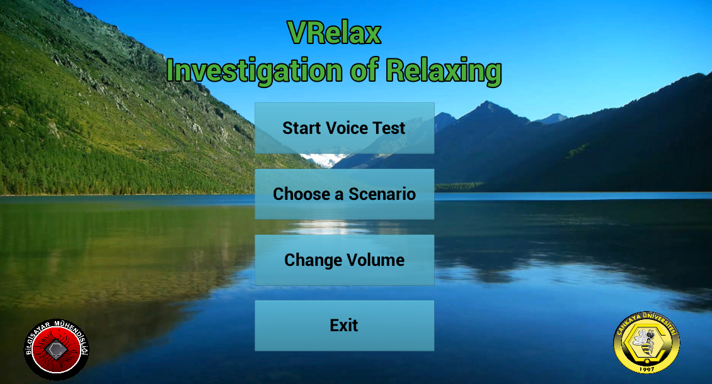
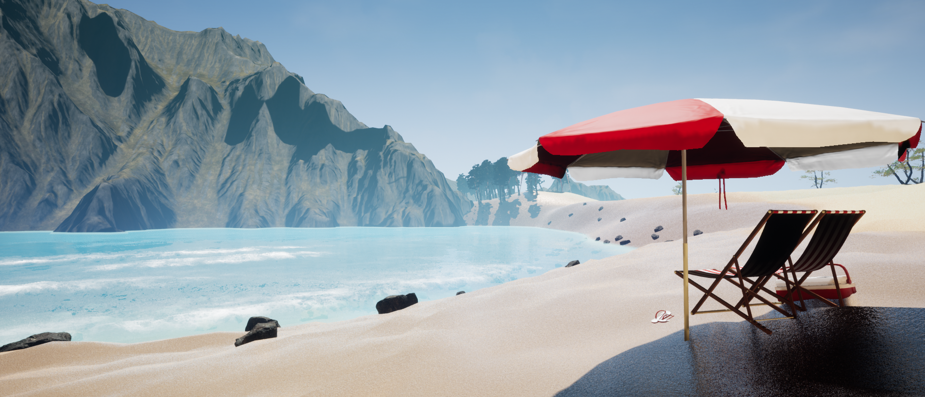

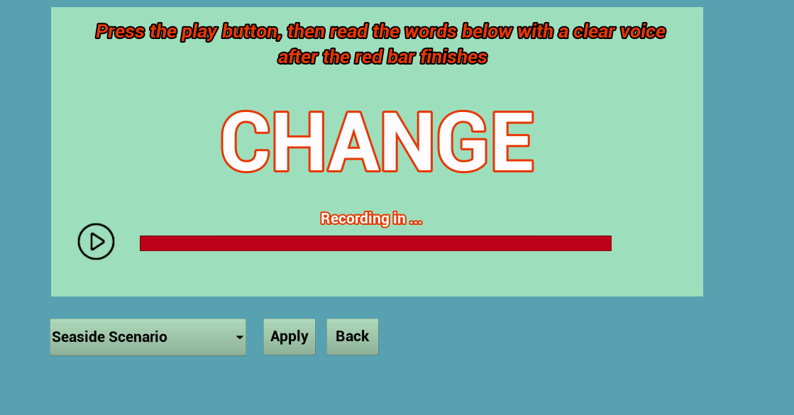
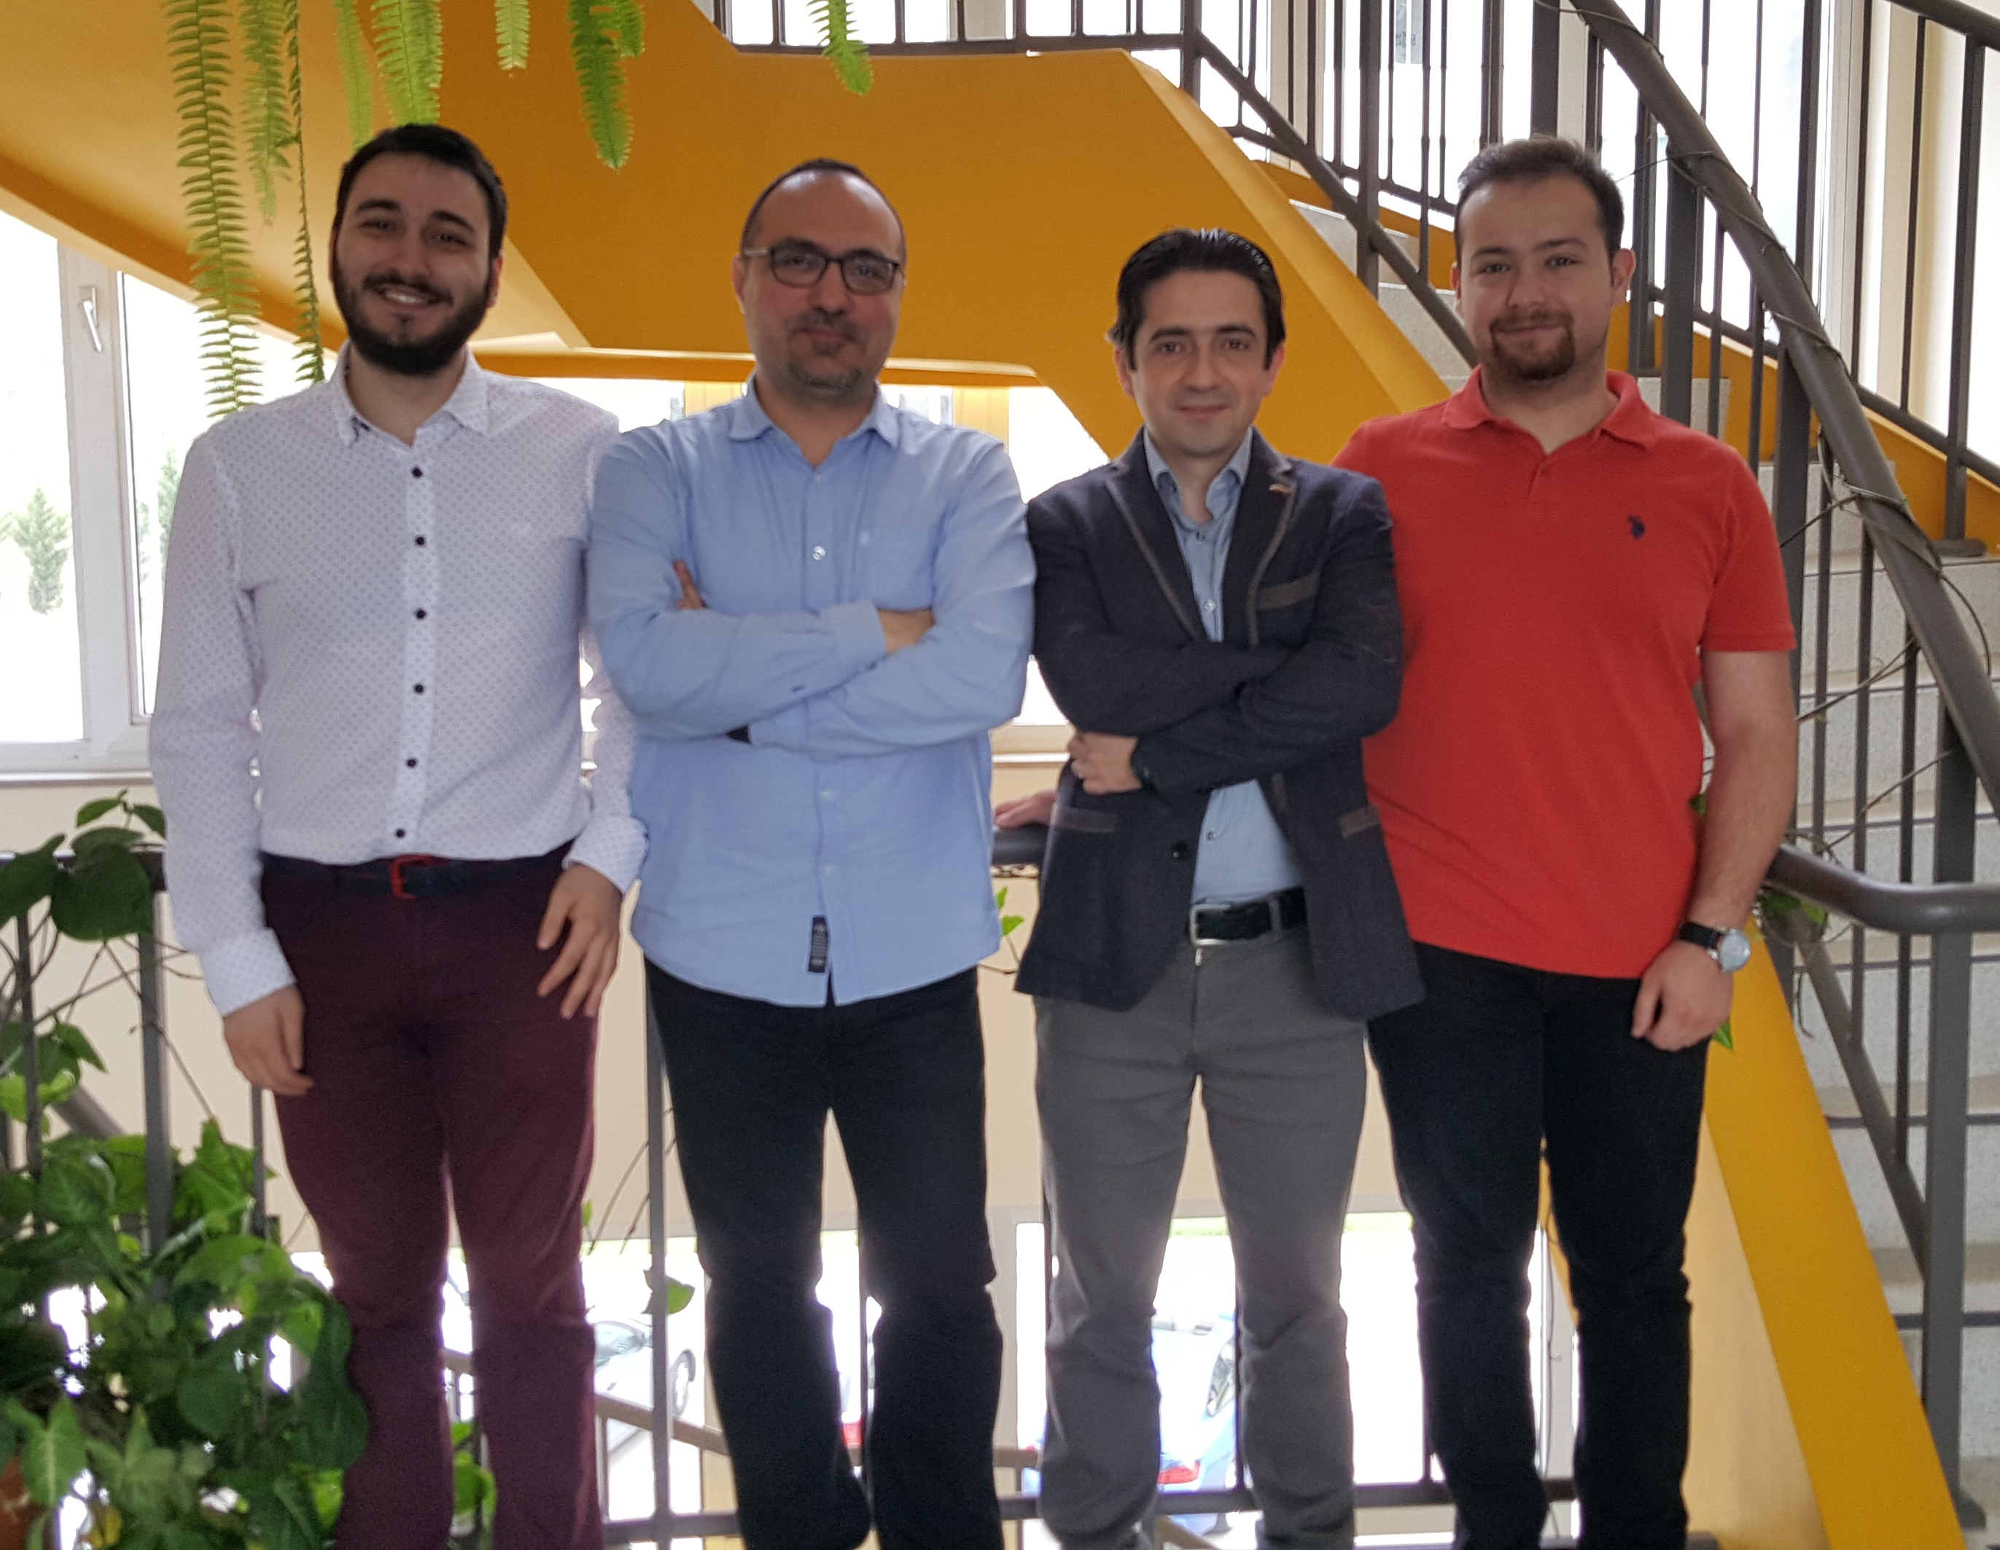

VRelax: Investigation of Relaxing
Görkem NARİNOĞLU – Umut EFİLOĞLU
Advisor : Dr. Faris Serdar TAŞEL
Co-Advisor : Assist. Prof. Dr. Murat YILMAZ
Çankaya University, Department of Computer Engineering
Abstract
Anxiety is a crucial disease for the people which is not only a problem that decreasing patients’ life quality, but also challenging situation for psychologists who are trying to examine this kind of patients. This project creates an opportunity for psychologists to understand these patients’ stressful moments, at the same time, allows patients to relax themselves on their own. Main purpose of this project is to detect participant’s stress level and try to reduce stress with relaxing scenarios. Because of the advanced sense of reality that VR headsets provide, VRelax can comfort participants more effectively than trying to comfort the participant via talking with him/her. Project’s main working principle is based on voice analysis process that a virtualized system created in a game engine will use this process to maximize utility, so participant shall be able to interact with the environment with different functional capabilities while analyzing stress. These interactions of participant and scenarios make the created world is more realistic to the participant which with this sense of reality makes reducing of stress relatively easy.
Key words: Virtual Reality, HTC Vive, Voice Analysis, Relaxing Scenario, Investigation of Relaxing
Company Info
Turkey’s radical, visionary and domestic IT software company Mebitech Bilişim was founded in 2012. It has taken its place in the market since the day it was founded and improved itself throughout the time according to the requirements of new technology and market.
Results & Conclusion
To develop VRelax, we have made a lot of research about stress analysis, usage of VR technologies and similar works. Our researches show that there are not many applications about this topic and they don’t have a stress analysis tool like VRelax has. One of the advantage of our project is to develop a product that can be reusable without wasting any resources. Therefore the product can be considered as cost effective. Also, even though the product is developed considering that it will be used with HTC Vive, it works even if the HTC Vive is not connected to the computer but VR provides immersion and more realistic environment. In conclusion, while researching for our project and preparing the documents we have learned many things and we will continue to learn.
Figure 1 – Activity Diagram
Introduction
Stimuli cause strong pressure for patients suffering intense anxiety problem. This pressure makes patients so stressful for psychological treatment, as well as, makes hard for patient to handle these stressful moments on his/her own. This project proposes new aspect to treat intense anxiety problem. This project provides the solution for patients to relax themselves on their own and assists psychologists to understand patients’ stressful moments. One ability of VRelax is detecting of participant’s stress level automatically which also eliminates the need of manual intervention by external system or user and simplifies using of this system. After detecting critical stress interval for participant, VRelax automatically start the relaxation scenario including visual and audio contents.
Acknowledgement
We are grateful for the help and guidance that we have received from our advisor Dr. Faris Serdar TAŞEL and co-advisor Assist. Prof. Dr. Murat YILMAZ. We improved both the project and ourselves thanks to their valuable comments and advices. We are also grateful to our proposer company Mebitech for giving us this opportunity. This work couldn’t have been possible without the offer received from them.
Solution
VRelax is a VR Application that involves multiple relaxation scenarios to help consultants comfort themselves easily with experiencing their favorite sights and by recognizing their voice; analyze their stress amount and make inferences from it. The solution for our main problem, stress analysis and reducibility, interactive scenarios that will analyze the stress amount of the participant with the VSA tool. Ability of VRelax is detecting of participant’s stress level automatically that eliminates manual intervention and make opportunity for the psychologists to understand participants stress better. Main programming language is C++ and environments created in Unreal Engine.
Figure 2 – Screenshots of Finished Product
Figure 3 – Working Company
Figure 4 – Project Staff

